Slide 1
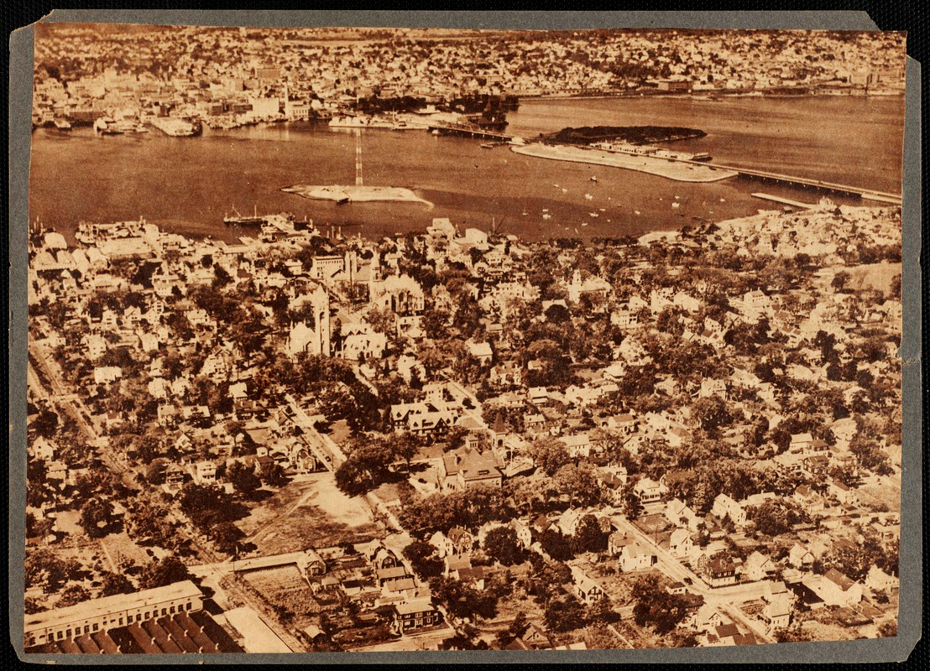
The Open Space and Recreation Plan Process
Fairhaven OSRP
February 2025 - May 2026
01

Slide 2
What is an Open Space and Recreation Plan (OSRP)?
A document that describes a community’s open space and recreation resources.
It is also a blueprint for action for open space and recreation decision-makers in a community.
Conservation
Commission
Parks
Commission
Cemetery
Commission
Planning
Board
Local
Citizens
02

Slide 3




Integrates many sources of data into one comprehensive picture of a community’s natural resources.
Why have an OSRP?
Educates residents about conservation and recreation issues and increases awareness of local resources.
Identifies actions that will protect and manage a community’s resources.
It makes communities eligible to apply for grants through the Division of Conservation Services.
03

Slide 4
Required OSRP Sections
Section 1 - Plan Summary
Section 2 - Introduction
Section 3 - Community Setting
Section 4 - Environmental Inventory and Analysis
Section 5 - Inventory of Lands of Conservation and Recreation Interest
Section 6 - Community Vision
Section 7 - Analysis of Needs
Section 8 - Goals and Objectives
Section 9 - Five-Year Action Plan
Section 10 - Public Comment
Section 11 - References
04

Slide 5








Required OSRP Maps
Regional Context
Environmental Justice
(If Applicable)
Zoning
Soils and Geologic Features
Unique Features
Water Resources
Open Space Inventory
Action Plan
05

Slide 6




Particularly Significant Elements
Open Space Inventory
Includes information on management agency, zoning, public access, condition, recreation potential, etc.
Action Plan
Lists actions that will implement the plan’s goals and objectives with a responsible party, potential funding source, and priority associated with each
ADA Plan
Administrative requirements and employment practices
Public Participation
Surveys, Public Meetings, Workshops, etc.
Helps to gather information on what community members feel is important to protect, what recreational activities they’d like to see, etc.
06

Slide 7
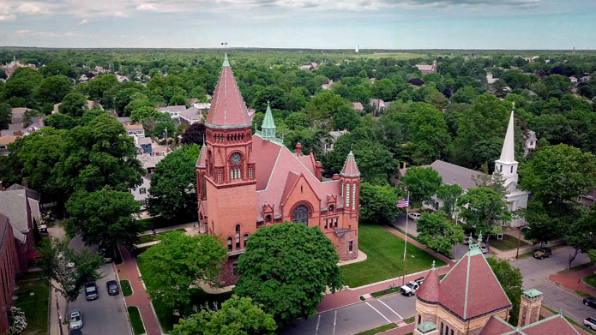
Fairhaven’s Open Space and Recreation Process
07

Slide 8


Task 1: Steering Committee Meetings
The committee will be made up of individuals from Town Staff, as well as various local stakeholder groups and citizens
There will be six (6) SC meetings throughout the Open Space Planning process
#1: Coordination + Outreach Survey, Website
#2: Previous Plan Review + Outreach Meeting
#3: Public Engagement Analysis + Review of Maps
#4: Preliminary Prioritization + Draft Status Updates
#5: Draft Action Plan Review + Public Meeting 2 Prep
#6: Final Review + Debrief Next Steps
08

Slide 9
Task 2: Public Engagement
There will be two (2) public workshops with the following parameters
One (1) workshop to discuss the goals and objectives for Open Space and Recreation in Fall River
One (1) workshop to vet the plan recommendations with the community
SRPEDD will create the advertisements for these meetings, with input from the Steering Committee on outlets for advertisements
SRPEDD and the Steering Committee members will publicize the workshop announcements throughout the community
An electronic survey will also be prepared by SRPEDD and distributed by the City and the Steering Committee members
09

Slide 10
Task 3:
Plan
Writing
Certain sections of the plan will not need to be updated. Data regarding underlying unchanging environmental features like geology, soils, aquifer areas, etc. can remain largely as written. A first step in plan development will be to identify and confirm these sections with the Steering Committee.
We will revise maps and figures, where needed, to be in a standard format and to reflect best available data.
We anticipate three draft documents
  One draft document for Steering Committee Review prior to the 2nd public meeting
  Second draft document for presentation at the 2nd public meeting
  Final draft document that incorporates all feedback for submission to the state for certification
We will assist in responding to any state comments received, and update / release the final plan.
10

Slide 11


Task 4: Open Space Inventory
Town Staff will provide up-to-date information on Open Space and Recreation lands and programming in Fairhaven
SRPEDD will work with the Steering Committee to verify the inventory and prepare a site matrix and map of Fairhaven’s open spaces
11

Slide 12
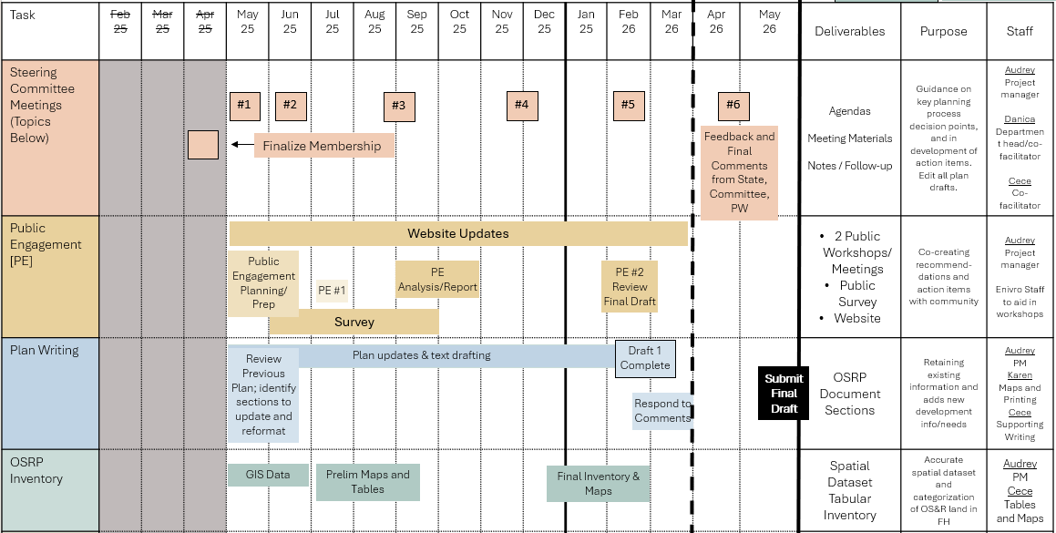
Steering Committee Schedule

