Slide 1
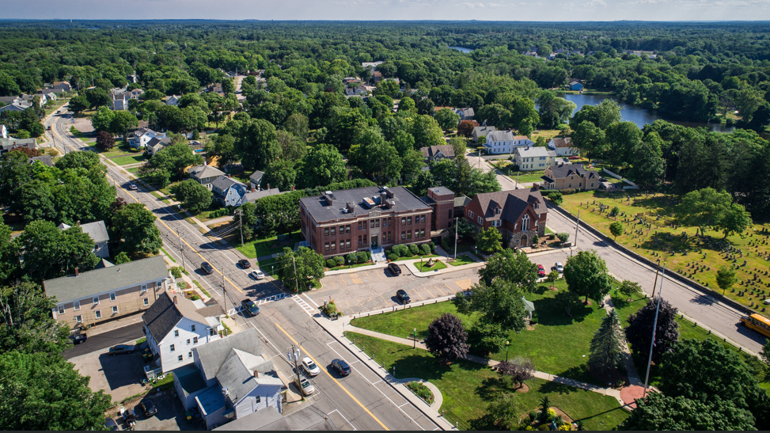


Mansfield Hazard Mitigation Plan

Slide 2


What is a Hazard Mitigation Plan?
A Hazard Mitigation Plan (HMP) is a strategic approached developed by communities to reduce the long-term risks to life and property from natural hazards.
Notes:
These are the steps of the plan as FEMA lays them out
Identifying
The HMP has to be approved by FEMA
We are here in the public participation phase to hear from you

Slide 3
What is in a Hazard Mitigation Plan?
Details about the Town, history, and existing plans
Plan Process
Who and how the plan is going to be developed, including outreach
Hazard Inventory
Listing of all of the weather hazards that could impact communities and to what degree and reach
Mitigation Strategies
How the Town is going to develop strategies, plans, and programs to minimize the impacts of those hazards
Updates and Maintenance to Plan
How the plan will be changed, implemented, and be updated moving forward
Town Context
Notes:
These are the steps of the plan as FEMA lays them out
Identifying
The HMP has to be approved by FEMA
We are here in the public participation phase to hear from you

Slide 4
Why Update or Create a Hazard Mitigation Plan?
Why do it? Hazard mitigation plans are essential for breaking the cycle of disaster damage and reconstruction. Conditions are constantly changing.
FEMA has developed planning tools to help government agencies develop mitigation plans. Local jurisdictions must have a FEMA-approved hazard mitigation plan to receive funding from the Hazard Mitigation Grant Program (HMGP) or Pre-Disaster Mitigation (PDM).
Mansfield is updating our plan from 2008

Slide 5
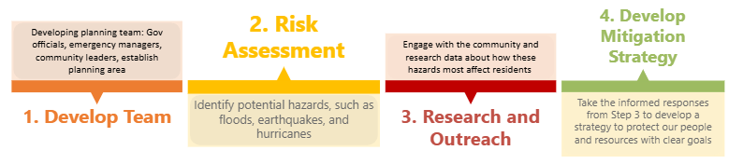
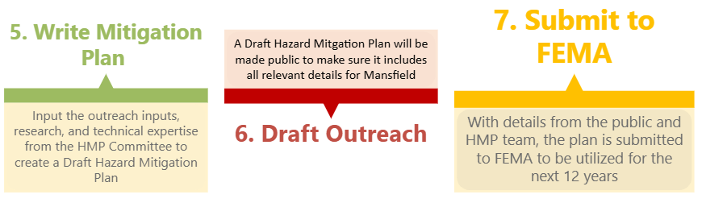
Committee Team and Project Process
Committee Members
  Katelyn Goyner, Conservation Agent and Environmental Planner
  Sharon Varricchione, Administrative Assistant, Conservation Agent
  Sarah Reposa, Director of Planning and Development
  Priscilla McGill, Administrative Assistant, Planning and Zoning
  Justin Derosiers, Fire Chief
  Rick Alves, Town Engineer
  Amy Donovan-Palmer, Health Agent
  Sacha Zlatkova, IT Director
  Kevin Dumas, Town Manager
  Ronald Sellon, Police Chief
We are here

Slide 6
Hazard Vulnerability Matrix
Hazard | Impact | Frequency | Distribution | Totals
Flooding | 3 | 3 | 3 | 9
Winter Storms | 2 | 3 | 3 | 8
Hurricane | 3 | 2 | 3 | 8
High Winds | 3 | 3 | 2 | 8
Extreme Cold | 2 | 2 | 3 | 7
Extreme Heat | 2 | 2 | 3 | 7
Drought | 2 | 1 | 3 | 7
Wildfire | 1 | 2 | 2 | 5
Tornado | 1 | 1 | 2 | 4
Earthquake | 0 | 1 | 3 | 3
Dam Failure | 0 | 0 | 1 | 3
Landslide | 0 | 0 | 1 | 1
A Hazard Matrix decides how to prioritize measures and strategies for the Town, regarding the hazard’s overall effect.
Hazards are found by looking at the required hazards by FEMA and climate projections by the State of Massachusetts Mapping Programs
Scores are determined by
Impact is how much damage, physical and mental cost to residents
Frequency is how often these hazards occur
Distribution is how broadly the hazards impact portions of our community
Notes:
How the Scores were developed
Impact Categorization
1 - Minor: Limited property damage; limited injuries or fatalities.
2 - Moderate: Scattered significant property damage; minor infrastructure damage; essential services are briefly interrupted; some injuries and/or fatalities.
3 - Major: Widespread major property damage, major public infrastructure damage (up to several days for repairs), with potential many injuries and/or fatalities.
Frequency Categorization
1 - Low: events that occur from once in 50 years to once in 100 years (1% to 2% per year)
2 - Moderate: events that occur from once in 5 years to once in 50 years (2% to 20% per year)
3 - High: events that occur more frequently than once in 5 years (Greater than 20% per year)
Distribution Categorization: (extent of impact on any locality for a particular event)
1 - Isolated: a single whole or partial community impacted
2 - Local: One community to several communities impacted
3 - Widespread: whole community is impacted
Joe:
Explain how we came up with the hazards and how we came up with the impact, frequency, and distribution definitions

Slide 7
Mitigation Strategies
Mitigation strategies are how to best create plans and methods to lower the impact and severity of hazards
  Types of Mitigation Strategies
    Infrastructure based: Culverts, dams, highway department maintenance
    Natural Systems: Retention ponds, vegetation management, green infrastructure
    Education based: Different strategies to teach parts of the town or public on relevant trainings and topics
    Local Plans: How to create management and other planning strategies to coincide or add to the needs of hazards
In this workshop, we will present them all for you to decide how important those strategies are to you, more directions to follow

Slide 8
Timeline and next steps for the rest of the project
We will use your input to calculate the prioritization of the mitigation strategies and integrate it into the hazard matrix. This will help the town decide which strategies to start with
End of July-August
  End of July: Will open up the final draft of the plan for open comment
  Early August: Present to the selectboard, zoning board, and conservation commission
  Mid August: Send the final draft presented to MEMA and FEMA for final approval

Slide 9

Comments?
Questions?

Slide 10
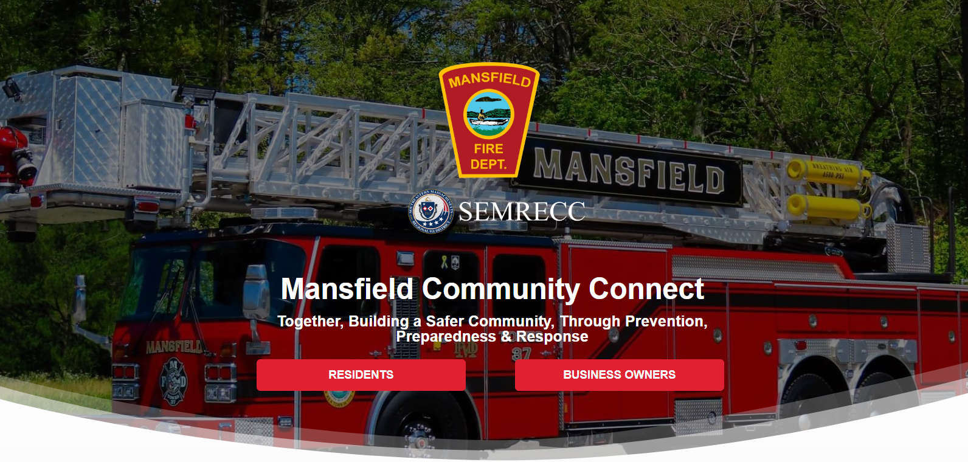

Notes:
Use write up for the community connect – use the website link

Slide 11





Activity around the room
Flooding
Other
1. Mapping Board to put areas where you know of weather hazards with colored stickers and pins
2. Mitigation Strategies
  Green and red stickers to indicate how important or not important (prioritizing) a strategy is to you
  Please feel free to add comments with sticky notes to emphasize certain points or add any component
3. Hazard Matrix
  Please add red and green stickers to indicate how concerned you are about certain hazards
  Please add comments on sticky notes to indicate specifically how those hazards have impacted you
Lower Concern
Higher Concern

Slide 12
Questions, Comments, Concerns?
Let us know!
Audrey Matthews
Senior Climate Planner
amatthews@srpedd.org
Joe Monet
Homeland Security Specialist
jmonet@srpedd.org

