Slide 1
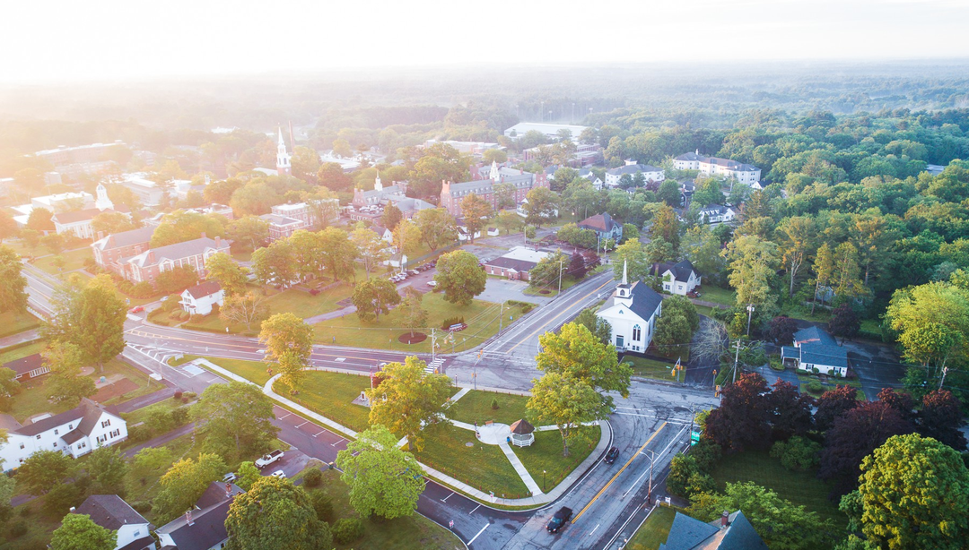
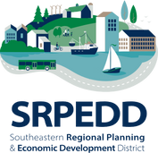
Nature-Sensitive Designs for Open Space & Housing in Southeastern Massachusetts
Presented by:
Danica Belknap, Environmental Planning Manager
Michelle Tinger, Assistant Director of Environmental Planning
Karen Pettinelli, Principal Natural Resources Planner
Panelists: Middleborough, Dighton, & Westport
June 11, 2025
Notes:
MT

Slide 2
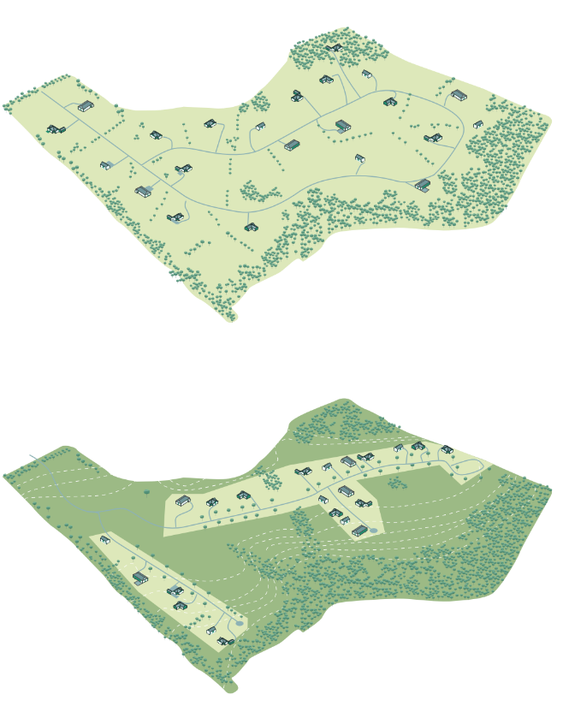
Agenda
01
Welcome
02
SRPEDD Overview & Introductions
03
OSRDs - What are they?
04
Regional Review
05
High-level Best Practices
06
Questions & Panel Discussions
Notes:
MT

Slide 3
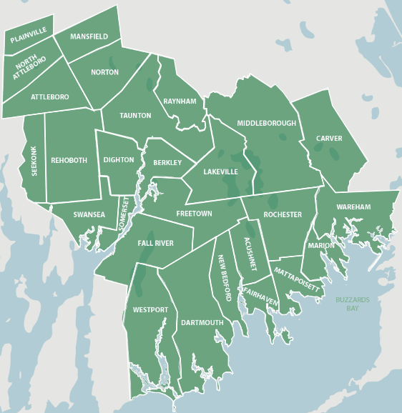



Welcome
SRPEDD Overview & Introductions
OSRDs - What are they?
Regional Review
High-level Best Practices
Questions & Panel Discussions
SRPEDD Overview & Introductions
SRPEDD is a regional planning agency serving 27 cities and towns in Southeastern Massachusetts. Governed by a Commission of local officials and citizens, we plan for the region’s land use, transportation, economy and environment while assisting member cities and towns to operate more efficiently. We seek to be a regional resource - a servant of local public servants and community groups, connecting the dots between local municipal needs and the funding, community outreach, and proactive planning resources that can address them.
Comprehensive Planning
Environmental Planning
Transportation
Notes:
MT

Slide 4
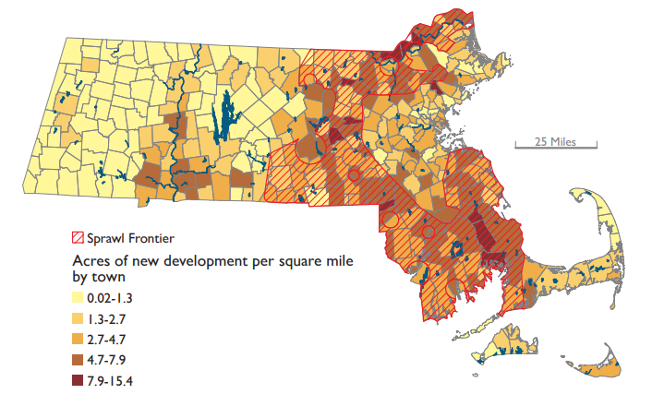
Welcome
SRPEDD Overview & Introductions
OSRDs - What are they?
Regional Review
High-level Best Practices
Questions & Panel Discussions
Why Are We Here? Why Is This Important?
Southeastern Massachusetts: At the Heart of the “Sprawl Curtain”
According to Mass Audubon’s Losing Ground report, Southeastern Massachusetts is part of the “Sprawl Curtain” – a region experiencing the highest rates of land development in the Commonwealth.
Why this matters
High rates of new development, especially in the Sprawl Frontier, often come with:
  Loss of open space and farmland
  Increased stormwater runoff and water quality concerns
  Greater vehicle miles traveled (VMT) and emissions
  Higher costs for municipal services and infrastructure extensions
Planning Implications
This trend underscores the urgency for more compact, sustainable development patterns.
It also justifies the need for zoning reforms, such as:
  Conservation Subdivisions
  Infill and mixed-use development
  Density bonuses in exchange for public benefits like affordable housing or preserved open space
Recent development trends in Massachusetts, 2005-2013
Source: Losing Ground – Planning for Resilience
Notes:
MT
Visual Aid: Map – Rate of New Development per Square Mile by Town
Color Scale:
Light Yellow (0.02–1.3 acres/sq mi): Low development pressure
Dark Brown to Maroon (7.9–15.4 acres/sq mi): High development pressure
Red Cross-Hatching: Indicates the “Sprawl Frontier” – areas facing intense land conversion from forests and farmland to development.
Key Takeaways:
Development is Uneven: The eastern and southeastern regions of Massachusetts are experiencing the highest rates of land development. In contrast, central and western towns show significantly lower rates of new development per square mile.
The Sprawl Frontier: -This is a term used to describe regions under intense pressure from low-density, car-dependent development. These areas are seeing rapid consumption of land without a proportional increase in housing density or infrastructure efficiency.

Slide 5
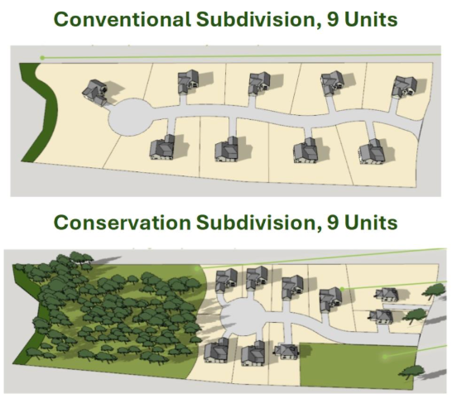
Welcome
SRPEDD Overview & Introductions
OSRDs - What are they?
Regional Review
High-level Best Practices
Questions & Panel Discussions
Open Space Residential Designs (OSRDs) - What are they, and how do they work?
OSRD bylaws—also known as “conservation subdivision,” “cluster,” or “natural resource protection” zoning—allow developers to create subdivisions with smaller lot sizes, provided that the remaining land is permanently preserved as open space.
Developers benefit by building the same number of housing units (or more) as in a conventional layout, while communities gain long-term land conservation.
By clustering homes on smaller lots, OSRDs reduce land disturbance and protect important natural resources, conserving large blocks of open space in the process.
Benefits of OSRDs
Municipal:
  Reduces infrastructure and maintenance costs
  Reduces demand to acquire new public parkland
  Maintains local character
Environmental:
  Protects unique or fragile habitats
  Reduces the pollution impacts of stormwater runoff
  Promotes aquifer recharge
  Provides opportunities to link wildlife habitats
  Conservation values are part of the planning process
  Can further goals of open space and community development plans
Social and Recreational:
  Reduces isolation and sprawl
  Enhances New England community character
  Promotes community involvement
  Provides neighborhood connections with an interconnected network of trails and open space
  Can be combined with 40B, the Local Initiative Program, to be an alternative to comprehensive permit to achieve affordable housing accreditation
Notes:
MT

Slide 6
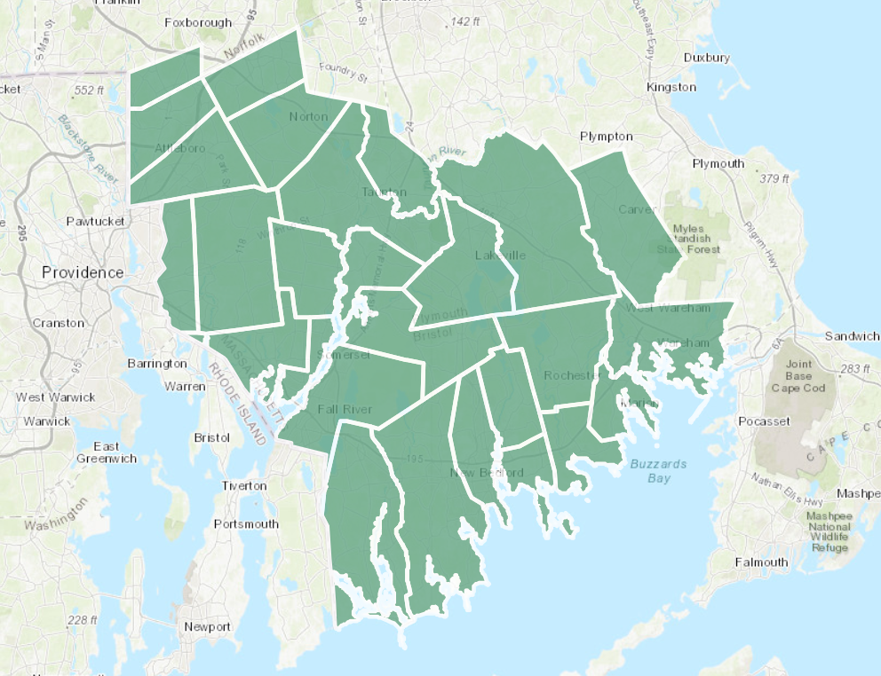






Welcome
SRPEDD Overview & Introductions
OSRDs - What are they?
Regional Review
High-level Best Practices
Questions & Panel Discussions
Regional Review Summary
Regional Bylaw Review
Community & Developer Interviews
Bylaw Updates (Dighton & Middleborough)
Peer-to-Peer Learning Exchange
SRPEDD completed a three-year project reviewing the existing OSRD-related bylaws in southeastern MA for low impact development design principles. Mass Audubon's Bylaw Review Tool was used to identify the bylaws in the region that support OSRD best practices.
SRPEDD conducted one-on-one interviews with communities to discuss their bylaws and explore regional challenges to adopting and implementing bylaws and potential solutions. SRPEDD also interviewed practicing developers, engineers and other planning professionals to further understand adoption strategies and challenges across the region.
SRPEDD reviewed the zoning bylaws of each of our 27 member communities for development types that include open space protection. We analyzed 26 bylaws across 20 communities that allow a type of OSRD. Bylaws were assessed against recommended best practices for low-impact and environmentally-conscious design outlined in the Mass Audubon’s Bylaw Review Tool . A database of each community's bylaws and alliance with best practices can be found on the project webpage .
Notes:
DB

Slide 7
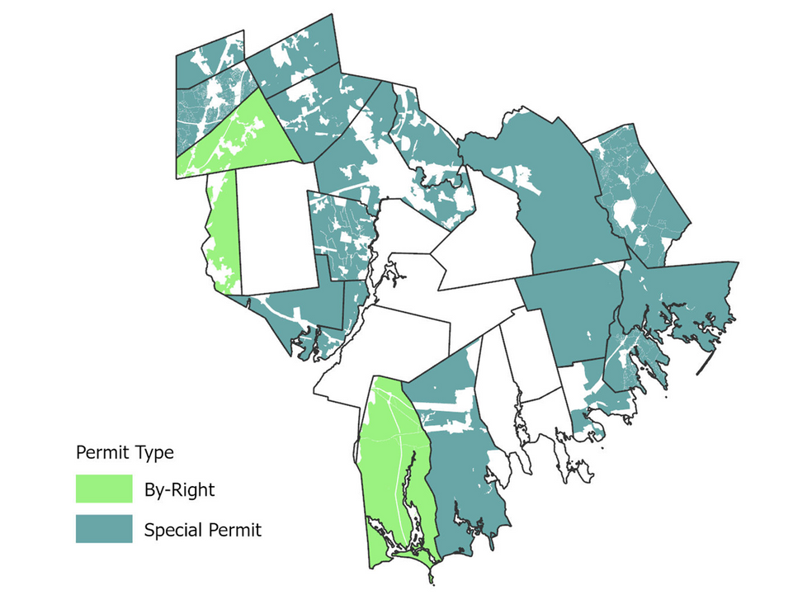
Welcome
SRPEDD Overview & Introductions
OSRDs - What are they?
Regional Review
High-level Best Practices
Questions & Panel Discussions
Key Findings: OSRDs in Southeastern MA
  70% of communities include OSRD provisions in their zoning bylaws.
      Only 3 communities allow it by-right, while 16 require a special permit.
      61% of the region’s land area – more than 313,000 acres – is zoned for OSRD
  6 communities (37%) require a design process that selects open space before roads or lot lines are drawn.
  7 communities (37%) offer density bonuses for meeting specific planning or conservation criteria.
  57% of communities interviewed (8 of 14) report that their OSRD bylaws have been actively used and implemented.
Notes:
DB

Slide 8
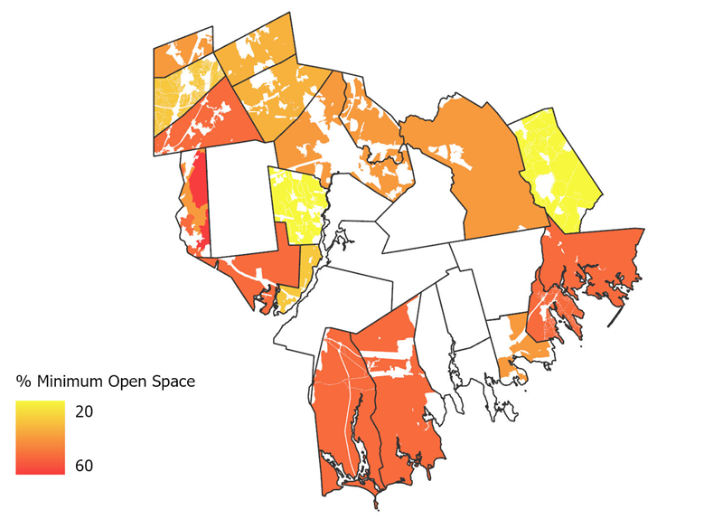
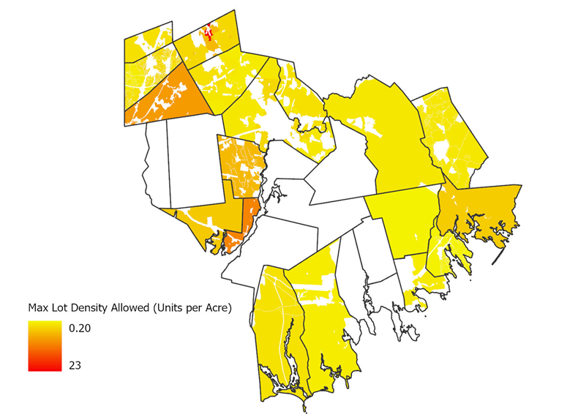
Welcome
SRPEDD Overview & Introductions
OSRDs - What are they?
Regional Review
High-level Best Practices
Questions & Panel Discussions
Key Findings: OSRDs in Southeastern MA
Minimum Open Space Requirements:
20 – 50% (39% average)
Maximum allowed housing lot density
1.09 – 22.23 units per acre (4.8 average)
2,500 – 43,560 sq. ft min lot size (16,400 average)
Notes:
DB
Highest min open space requirement is 50%, adopted by 6 communities
Emphasize max allowed density is within the buildable area only
Highest allowed density 22.23 units per acre is within Mansfield
Smallest min lot size is 2,500 sq. ft. in Mansfield’s high-density residential district.

Slide 9
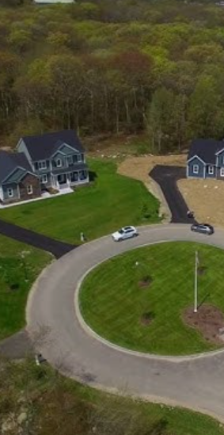
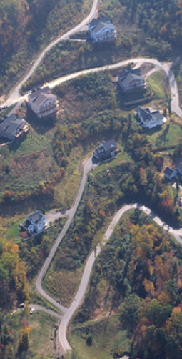
Welcome
SRPEDD Overview & Introductions
OSRDs - What are they?
Regional Review
High-level Best Practices
Questions & Panel Discussions
Interviews
Community Takeaways
01
Local utilization of OSRD
  Over 50% of communities are seeing their bylaws utilized
  Generally identified “best practices” on paper don’t necessarily correlate with success on the ground
  A committed Planning Board seems to be more effective at ensuring low impact & environmentally conscious design
02
Challenges to implementing OSRD
  Ensuring meaningful open space designation and low impact design is challenge when permitting OSRDs
  Ownership & maintenance of open space
  Larger parcels for subdivision are rare across the region → need to shift strategy?
  Educational disconnect between higher density & environmental protection
Developer & Engineer Takeaways
The appeal of OSRD
01
  Special permit isn’t necessarily more difficult than by-right
  Ease of permitting depends more on the planning board’s flexibility and the required level of detail for the yield plan
  Savings on construction costs (infrastructure & roads) is a worthwhile incentive for OSRD
  Surrounding open space does not increase home sale values
Notes:
DB

Slide 10

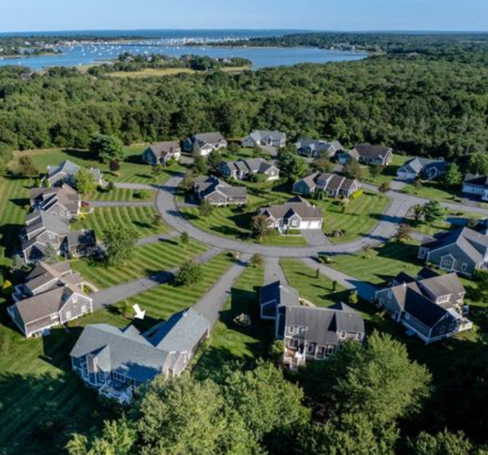

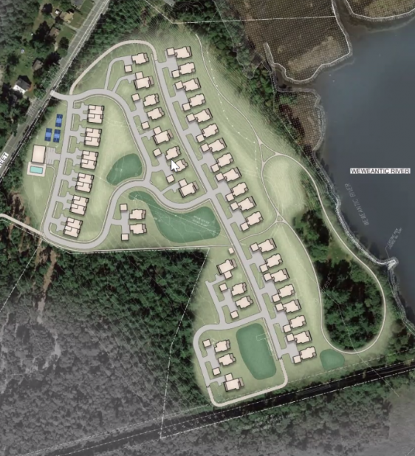
Welcome
SRPEDD Overview & Introductions
OSRDs - What are they?
Regional Review
High-level Best Practices
Questions & Panel Discussions
OSRD Best Practices
Within the SRPEDD region, municipal zoning bylaws offer examples of OSRD-type bylaws and language for low-impact and environmentally conscious design. These range from “Conventional” to “Better” to “Best” practices as defined by Mass Audubon’s Bylaw Review Tool. Best practices – those that most strongly support OSRDs – include the following factors:
  Permit Type
  Land Area to Which the Zoning is Applicable
  Minimum Open Space Preserved
  Yield Calculations
  Minimum Parcel Sizes
  Review Process (Open Space Selection)
  Ownership of Open Spaces
  Dimensional Standards (per individual low creates); Area, Frontage, etc.
  Quality of Open Space Conserved: Specific Criteria, Maps or Local Priorities Identified for Natural, Cultural, and Historic Resources Conservation
  Contiguity of Open Space; Relationship to Previously Protected Open Spaces
  Quality of Open Spaces Conserved: Allowed Uses of Open Space
  Quality of Open Space conserved: Submission requirements – GIS Maps, Data, etc. to Inform the Review Process
  Relationship to Plans
  Low Impact Development (LID) Design
  Density Bonus for Enhances Public Benefits
  Review Entity
  Flexibility regarding open space protection to facilities wastewater treatment facilities
  Monitoring and/or Maintenance of Open Spaces
  Housing Type Requirements and/or Restrictions (i.e. senior, affordable, veterans)
  Housing Types Allowed (Single vs Multi-Family)
Open Space Residential Design (OSRD): Best Practices for Green Zoning By-Law in Southeastern MA
https://storymaps.arcgis.com/stories/416a394415104f78bef2ead43027c12b
Notes:
MT
Mentioned why some #s are highlighted in the list while others are not for context.

Slide 11
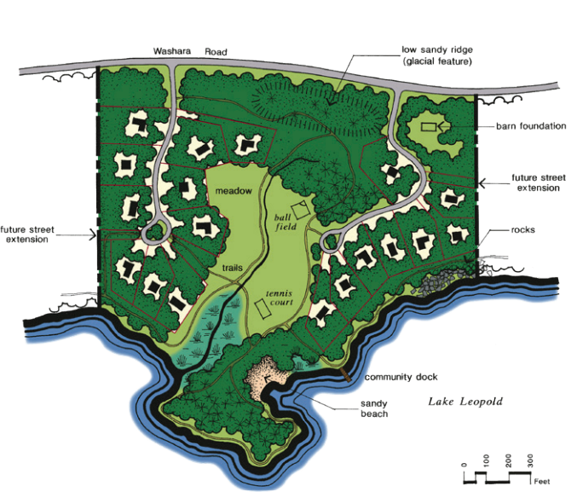
Welcome
SRPEDD Overview & Introductions
OSRDs - What are they?
Regional Review
High-level Best Practices
Questions & Panel Discussions
OSRD Best Practices in the SRPEDD Region
Municipal bylaws offer examples within the SRPEDD region of best practice factors that support OSRD-type zoning for low-impact and environmentally conscious development. The zoning code in which the best practice factors are supported provide a reference point for communities interested in adopting OSRD bylaws to support conservation development strategies in the region.
The following community bylaws support Mass Audubon’s best practice factors for OSRD-type development:
Best Practice Factor 1: Permit Type
Best Practice Factor 6: Review Process (Open Space Selection)
  Best Practice – Mandatory
  Community Example: While there is no current example within the SRPEDD region, communities such as Amherst require the use of OSRD in certain areas—particularly where agricultural land is present—to ensure its protection through conservation-focused development.
Best Practice – Flexible “OSRD” 4-Step Process, Prioritizing Selection of Open Space First
Community Examples: Attleboro, Carver, Dartmouth, Dighton, Marion, Seekonk, Swansea, & Westport
Source: American Planning Association
Notes:
MT: Best Practice Factor 1, 6
Talking points: Conventional: Special Permit; Better: By-Right
Why are these best practices?
Permit Type:
Requiring OSRD by-right or mandatorily ensures that developers follow conservation-focused design principles rather than defaulting to conventional subdivisions. This removes discretion and creates predictability, reducing barriers for planners trying to preserve open space.
When OSRD is optional, developers may avoid it due to perceived complexity or uncertainty. Mandating it in specific areas—especially those with agricultural or environmentally sensitive lands—ensures critical natural resources are prioritized for protection. It shifts development toward a more sustainable, landscape-sensitive form.
Although the SRPEDD region currently lacks a mandatory OSRD bylaw, communities like Amherst require it in designated zones (e.g., agricultural land), ensuring proactive conservation and aligning development with long-term land use goals.
Review Process
A flexible, multi-step review process that begins with identifying and prioritizing open space leads to better site planning. It reverses the typical subdivision approach, where house lots are planned first and leftover space is considered open space.
This approach ensures the most valuable environmental, agricultural, scenic, or recreational lands are protected first. It promotes intentional conservation rather than fragmented, low-value remnants. The 4-step process encourages thoughtful development that works with the land rather than against it.
Several SRPEDD communities (e.g., Attleboro, Dartmouth, Dighton, Westport) already include flexible review processes that prioritize open space. This regional adoption supports consistent conservation outcomes and encourages peer learning among municipalities.
These practices reflect the shift toward smarter, sustainable land use and are key to successful implementation of OSRD across communities.
Handout – 1 pager + the list of all best practices with examples

Slide 12
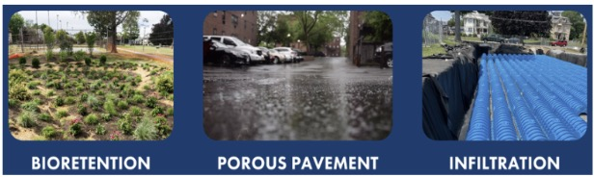
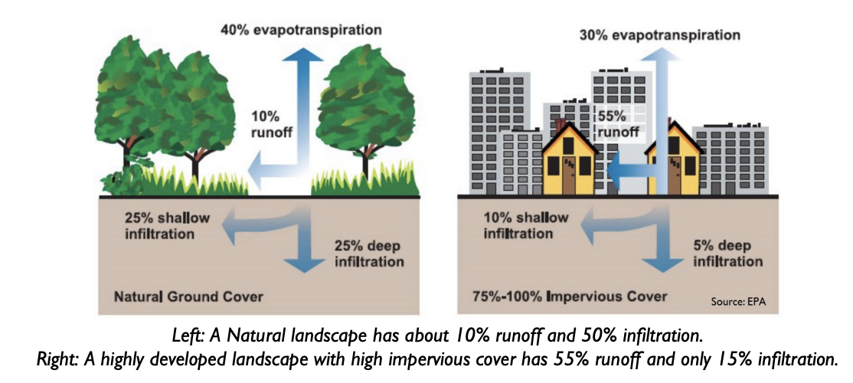
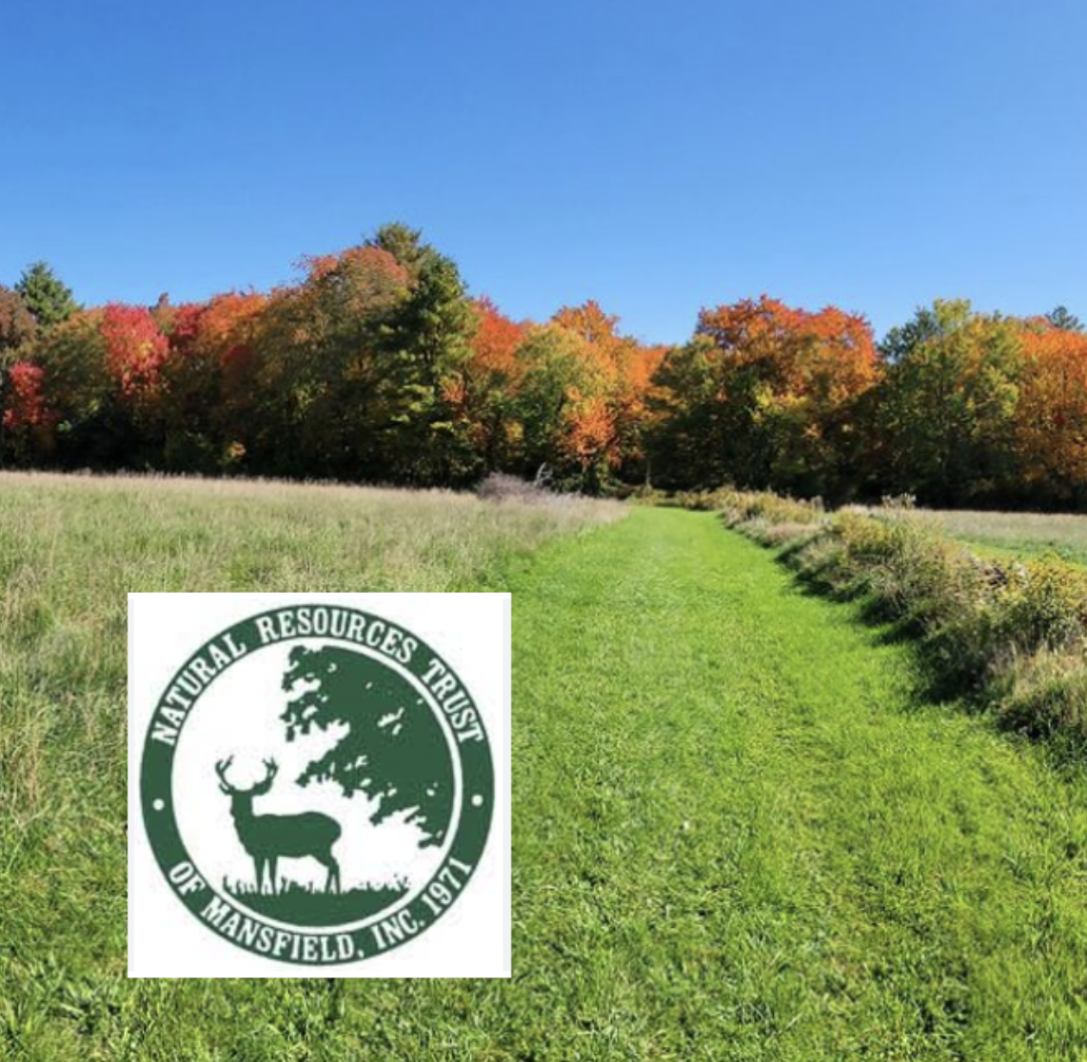
Welcome
SRPEDD Overview & Introductions
OSRDs - What are they?
Regional Review
High-level Best Practices
Questions & Panel Discussions
OSRD Best Practices in the SRPEDD Region (continued)
Best Practice Factor 7: Ownership of Open Space
Best Practice Factor 14: Low Impact Design (LID)
  Best Practice – Appropriate to the Resources Present
  (Examples: agricultural land by the farmer, watershed land by a water dept. or district, habitat land by the conservation commission, or recreational open space by a parks and recreation commission or homeowners association)
  Community Examples: Freetown
Best Practice – Required
Community Examples:
Freetown, Marion,
Swansea, Wareham,
Westport
Best Practice Factor 18: Monitoring and/or Maintenance of Open Space
LID works to preserve the natural landscape and minimize impervious surfaces to keep stormwater close to the source and use it as a resource rather than a waste product.
Best Practice – Specific Provisions to Aid Endowed Monitoring by a Conservation Organization at Stated Intervals
Community Examples: Mansfield
Source: MA Audubon LID Fact Sheet. file:///Users/karenpettinelli/Downloads/LID-fact-sheet-1-valuing-gi_revised.pdf
Notes:
KLP: Best Practice Factor 7, 14, 18

Slide 13
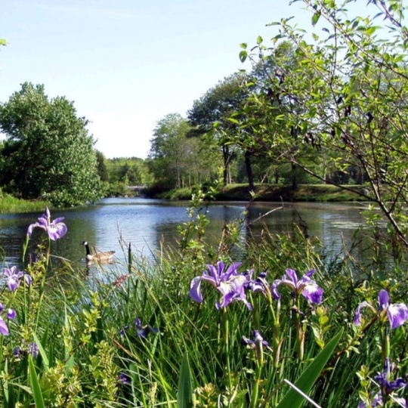
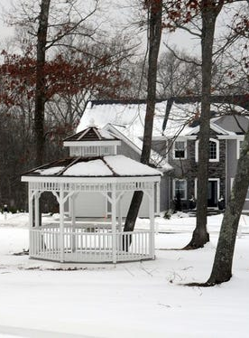
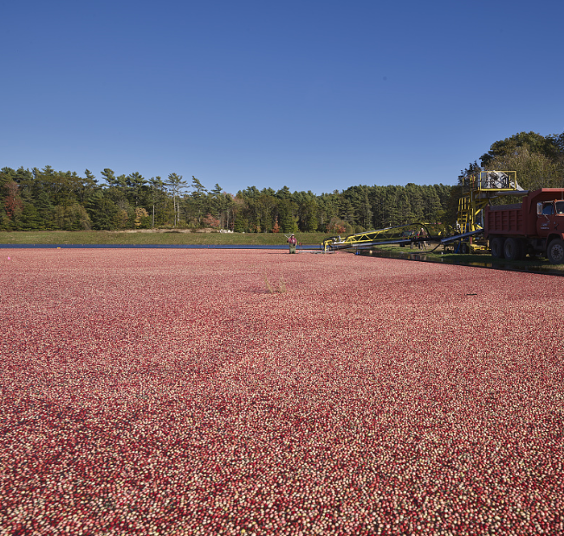
Welcome
SRPEDD Overview & Introductions
OSRDs - What are they?
Regional Review
High-level Best Practices
Questions & Panel Discussions
Questions & Panel Discussion
Open Space Residential Design (OSRD) represents a forward-thinking approach to land development that harmonizes residential growth with environmental preservation. By prioritizing the conservation of natural landscapes and integrating open spaces into community planning, OSRD not only safeguards biodiversity and ecological health but also enhances the quality of life for residents. This sustainable development model fosters a sense of community, promotes active lifestyles, and ensures that natural beauty remains an integral part of our living environments. Embracing OSRD principles is a step toward resilient, vibrant, and ecologically responsible communities.
Panelists
Dighton- Kerrie Easterday, Planning Board Office Manager
Middleborough –Patricia Cassady, Conservation Agent
Westport – Jim Whitin, Planning Board Chairman
Notes:
MT

Slide 14
Welcome
SRPEDD Overview & Introductions
OSRDs - What are they?
Regional Review
High-level Best Practices
Questions & Panel Discussions
Questions & Panel Discussion
Challenges and Need for Change
What are the most pressing challenges that traditional subdivisions present to your community?
Can OSRDs address some of the challenges that conventional development has brought to your community?
From your experience, what are the greatest barriers to adopting or implementing OSRD bylaws?
What blocks developers from choosing an OSRD? What are things we could do to better incentivize them?
Special Permit vs By-Right – what are the benefits and downsides of each approach for OSRDs?
Planning and Design
Can you share how your community approached identifying “priority open space areas” during the OSRD planning process?
What design features or planning practices have made your OSRD projects more successful or better aligned with community values?
What best practices have made your OSRD bylaw more effective or implementable?
Has lack of public infrastructure (particularly water & sewer) been a barrier in your community? How have you addressed that?
Implementation and Engagement
How do you engage Planning Board members, residents, and developers in revising or adopting your OSRD bylaw?
How are long-term maintenance plans for the preservation of open space typically handled?
What zoning bylaw updates might be helpful? How effective are bylaw updates in supporting the implementation of OSRD-type developments?
Benefits and Tradeoffs
What have been the most significant environmental or community benefits OSRDs have offered your community?
Have you seen evidence that OSRDs reduce infrastructure costs or increase property values over time?
Have OSRDs helped your community maintain its rural character while still accommodating housing needs?
Lessons Learned and Advice
What advice would you offer to communities who are starting to think about updating or implementing an OSRD bylaw?
How do you see the future of conservation-based subdivision design evolving, especially with the growing need for environmental resilience strategies and increased housing demands?
Which communities do you look to for inspiration or model bylaws when considering best practices in OSRDs?
Notes:
MT facilitate
MT/DB/KLP – prompt questions as topics come up to guide conversations
**Ask all panelists to respond to the Lessons Learned and Advice” at the end to close up

Slide 15
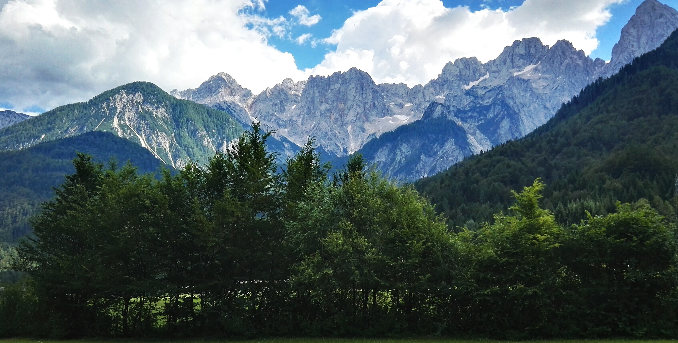




Thank You
We value your feedback! – Was this workshop helpful? What support or resources would help your community advance nature-sensitive design or OSRD implementation?
Contact Us
508-824-2367
https://srpedd.org/environment/osrd/
mtinger@srpedd.org
88 Broadway Street, Taunton, MA 02780

